Slide 1
Recording Arts Intro Part 2
Fall 2015

Slide 2
How sound waves interact…
When different waves collide (e.g. sound from different sources) they interfere with each other. This is called, unsurprisingly, wave interference.

Slide 3
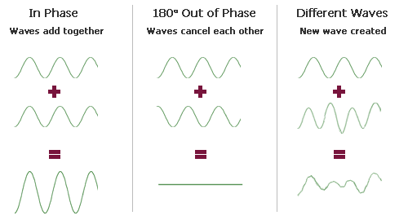
Sound waves which are exactly in phase add together to produce a stronger wave.
Sound waves which are exactly inverted, or 180 degrees out of phase, cancel each other out and produce silence. This is how many noise-cancellation devices work.
Sound waves which have varying phase relationships produce differing sound effects.

Slide 4
ENVELOPE (ADSR):
Attack refers to the time taken fro a sound to build up to its full volume when a note is initially sounded.
Decay refers to how quickly the sound levels off to a sustain level after the initial peak.
Sustain refers to the duration of the ongoing sound that’s generated following the initial attack decay.
Release relates to how quickly the sound will decay one the note is released.

Slide 5
DECIBEL
The unit used for measuring sound-pressure level SPL, signal level and relative changes in a signal level is the decibel (dB), a term that literally mean 1/10 of a Bell…a telephone transmission
Named after Alexander Graham Bell. There are different logarithmic formula to determine dB and SPL. If you love the math side of this you can look it up.
Whenever a source/pickup distance is doubled the SPL level is reduced by 6dB; as the distance is halved, it will decrease by 6 dB.

Slide 6
Harmonic Content
A440 Hz (initial pitch), 880 Hz – one octave higher, 1760 Hz – two octaves higher etc.
Sine wave
Square wave
Triangle wave
Sawtooth wave

Slide 7
Simple Sound System
Transducer - A device that converts energy from one form into another. The two types of transducers we will deal with are microphones (which convert acoustical energy into electrical energy) and speakers (which convert electrical energy into acoustical energy).
Amplifier - A device that takes a signal and increases its power (i.e. it increases the amplitude).

Slide 8
The process begins with a sound source (such as a human voice), which creates waves of sound (acoustical energy).
These waves are detected by a transducer (microphone), which converts them to electrical energy.
The electrical signal from the microphone is very weak, and must be fed to an amplifier before anything serious can be done with it.
The loudspeaker converts the electrical signal back into sound waves, which are heard by human ears.

Slide 9
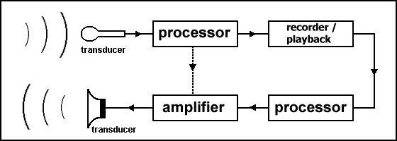
Signal processors - devices and software that allow the manipulation of the signal in various ways. The most common processors are tonal adjusters such as bass and treble controls.
Record and playback section - devices that convert a signal to a storage format for later reproduction. Recorders are available in many different forms, including magnetic tape, optical CD, computer hard drive, etc.

