Slide 1
Recording Arts…Audio Sound Waves
Fall 2015

Slide 2
What does this all mean to you in this class?
You are always working with sound waves – it is important to understand the basics of how they work.
Terminology…we will use it all year long.
The lesson information will impact your hearing.

Slide 3
Sound Waves
Sound waves exist as variations of pressure in a medium such as air. Sound waves are created when an object causes the air around it to vibrate. The vibrating air then causes the human eardrum to vibrate, which the brain interprets as sound.

Slide 4
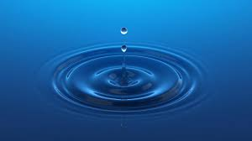
Sound waves travel through air in much the same way as water waves travel through water. In fact, since water waves are easy to see and understand, they are often used as an analogy to illustrate how sound waves behave.

Slide 5
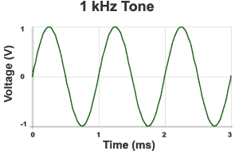
Sound waves can also be shown in a standard x vs y graph. This allows us to visualize and work with waves from a mathematical point of view. The resulting curves are known as the "waveform" (i.e. the form of the wave.)

Slide 6
The wave on the previous slide represents a constant tone at a set frequency. You will have heard this noise being used as a test or identification signal. This "test tone" creates a nice smooth wave that is ideal for technical purposes.
Test Tone (22KB wav file)
The waveform graph is two-dimensional but in the real world sound waves are three-dimensional. The graph indicates a wave traveling along a path from left to right, but real sound waves travel in an expanding sphere from the source. A 2-dimensional model works helps you think about how sound travels from one place to another.

Slide 7
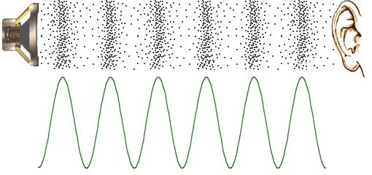
In the diagram below, the black dots represent air molecules. As a speaker vibrates, it causes the surrounding molecules to vibrate in a particular pattern represented by the waveform. The vibrating air then causes the listener's eardrum to vibrate in the same pattern.

Slide 8
Air molecules do not actually travel from the speaker to the ear (that would be wind). Each individual molecule only moves a small distance as it vibrates, but it causes the adjacent molecules to vibrate in a rippling effect all the way to the ear.
Here’s why this is important:
All audio work is about manipulating sound waves. The end result of your work is a series of high and low pressure zones. Sound waves are the "material" of your art.

Slide 9
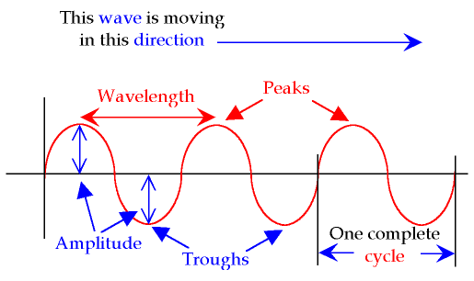
Sound Waves

Slide 10
Sound Waves Properties
There are three main properties of sound waves that are important to audio work.
Wavelength
Amplitude
Frequency

Slide 11
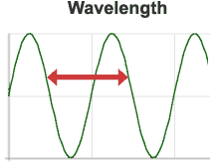
The distance between any point on a wave and the equivalent point on the next phase. Literally, the length of the wave.

Slide 12
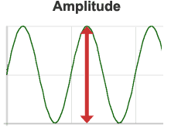
The strength or power of a wave signal. The "height" of a wave when viewed as a graph. Higher amplitudes are interpreted as a higher volume, hence the name "amplifier" for a device that increases amplitude.

Slide 13
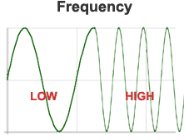
The number of times the wavelength occurs in one second. Measured in kilohertz (Khz), or cycles per second. The faster the sound source vibrates, the higher the frequency. Higher frequencies are interpreted as a higher pitch. For example, when you sing in a high-pitched voice you are forcing your vocal chords to vibrate quickly.

Slide 14
Frequency:
Frequency is defined as "the number of complete cycles (complete waves) in one second".
Hertz is the unit of frequency (symbol Hz).
1 Hertz = 1 cycle per second.
We will use Hertz and Kilohertz all the time in this class:
Hertz = Hz
Kilohertz = kHz

Slide 15
Sound Waves

Slide 16
Range of Human Hearing
20 Hz – 20,000 Hz
or
20 Hz – 20 kHz

Slide 17
Range of Hearing
http://www.youtube.com/watch?v=2G9Q-r2leyw
Ear Training
http://homerecording.about.com/od/homestudiobasics/a/test_tones.htm
Online Frequency Generator
http://plasticity.szynalski.com/tone-generator.htm

Slide 18
Wavelength
Wavelength = Speed of Sound / Cycles per second
Vocalist sings the note A at 440 Hz.
1130 / 440 = 2.56 ft or 30.72 inches
Low E on Electronic Bass ~ 40 Hz
1130 / 40 = 28.25 ft or 339 inches
Screaming Guitar Lead @ 1175 Hz
1130 / 1175 = .96 ft or 11.5 inches

Slide 19
Decibels AUDIO
A logarithmic unit to measure ampliture/sound pressure..
0 db is the threshold of hearing
10 db is 10 times greater
20 db is 100 times greater
30 db is a 1000 times greater

Slide 20
Threshold of Hearing (TOH) 0 dB
Rustling Leaves 10 dB
Whisper 20 dB
Normal Conversation 60 dB
Busy Street Traffic 70 dB
Vacuum Cleaner 80 dB
Large Orchestra 98 dB
Level Front Rows of Rock Concert 110 dB
Threshold of Pain 130 dB
Military Jet Takeoff 140 dB
Instant Perforation of Eardrum 160 dB

Slide 21
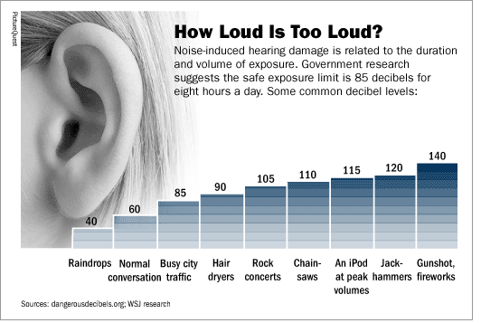

Slide 22
Vaccum Cleaner 80db
Rock Concert 110 db
Difference of 30 db or 1000 times louder
Therefore the average rock concert is equal to listening to 1000 vacuum cleaners running at the same time

Slide 23
What does this all mean to you in this class?
You are always working with sound waves – it is important to understand the basics of how they work.
Frequency, measured in Hz and kHz will become part of our daily discussion and listening.
Decibels impact your hearing – take care of your hearing!

