Slide 1
Inspire School of Arts and Science
Jim White

Slide 2
What is Reverb?
Reverb or ‘reverberation’ is not simply just an effect which makes vocals sound nice! It is what we hear everyday and allows us to almost ‘hear’ the environment around us. If you were to shout inside a tunnel, your voice (the ‘direct’ sound) would travel outwards to bounce off surfaces around in all kinds of directions which eventually return back to your ears, it is these reflected sounds that is the reverberation.

Slide 3
How can reverb help my mix?
Reverb within music productions helps to give a mix depth, if panning is the tool to let you decide where elements are placed between the left and right speaker, it is reverb which lets you decide whether an instrument is right in front of you or set further backwards within your mix. While there are no rules or specific instruments which strictly require the effect, once understood it will give you the ability to place an instrument exactly where you want it.

Slide 4
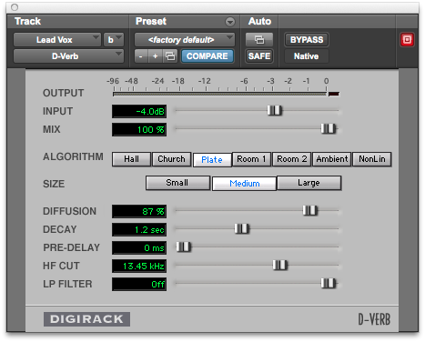

Slide 5
Output meter: This meter will show the output of the sound after processing, if this is clipping then you may need to tweak your input signal slightly.
Input: The input level slider simply sets how loud the signal coming into the plug-in is, this can be brought down if the signal is clipping or brought up if your signal level is fine and you simply want to hear a little more of the processed signal.

Slide 6
Mix:
This slider will allow you to set a mix value percentage between your direct sound and your reverberant sounds. Going back to our earlier tunnel example, 0% would be just the pure shout sound, and 100% would be the sound of the reflections bounced off the tunnel. 50% is generally a good place to start from which you can tweak it to hear more of your original or modified sound. In this instance, you will control the wet/dry mix using each source track’s send level.

Slide 8
Diffusion: Diffusion refers to the distribution of sound pressure in a space. A room is fully diffuse when sound is evenly distributed throughout the room after propagation (after sound waves have traveled in the room.)
Decay: This time-based parameter denotes how long the reverberation continues after the direct sound has ended. To avoid a ‘muddy’ sounding instrument, you might find it useful to change the decay value so that the reverberant sound has faded before the next instance of the direct sound; such as on snare drums. An inappropriate decay setting will cause an unwanted build up of reverb and will make your instruments much less defined.

Slide 9
Pre-Delay:
This value sets the time between the original direct sound and the reverberation that follows it. The easiest way of thinking about it again is the tunnel example, the sound of a shout in a small tunnel will be very different to that of a larger sized tunnel as the time taken for it to reach the edges is different, this is the equivalent of the pre-delay value. Usually, you will want some degree of pre-delay as the listener would hear the direct sound before the reverberant field.

Slide 11
Frequency Manipulation:
An often overlooked consideration when working with reverb are the frequencies which will be present within the reverberant sound. If you have a high-frequency dominant instrument with a reverb applied, these frequencies will of course be dominant in the reverberant sound which has the potential to mix and slur other instruments that are within the same range, we therefore need to filter the reverberant sound to help it sit more comfortably within the mix.

Slide 12
The hi-frequency cut slider will allow you to set a frequency cut-off to make higher frequencies less dominant after the direct sound. By moving the slider hard to the right hand side you can set it ‘off’ which will leave the sound untouched.
The low pass filter sets the frequency value above which a 6dB per octave filter will cutoff the reverberant signal.
The two filters work together to shape the sound of the reverb you are applying, you should tweak both untill you feel that you can comfortably hear the reverberant effect while making sure that it is not obstructing the sound of any other instruments within your mix.

Slide 14
Algorithms:
There are a number of algorithms in the middle of the plug-in. These are almost like starting pre-set values for you to work from and I believe it is best to actually understand what is being tweaked before delving into these to avoid the temptation of settling for a pre-set values. You will have the option of seven space algorithms (digitally recreated environments) within the D-verb plug-in, while the names will be familiar, lets first talk about what sonic effect you should expect from each of them.

Slide 15
Hall: This represents a general concert hall with a natural sounding character, perhaps useful on flowing orchestral sounds to sit in the background of your mix.
Church: Can be tricky to distinguish from the hall algorithm, however this setting will produce a much more diffuse sound with a long decay time and a slightly longer pre-delay to emulate the expected surface distances.

Slide 17
Plate: Emulates how false reverb was created before digital plug-ins, where a sound was sent to a vibrating metal plate from which vibrations were then captured. Plate reverbs tend to sound bright and work particularly well on vocals and percussive elements.
Room 1: A medium sized room with very natural sounding reflections.
Room 2: A smaller and brighter environment which can be used when only a very subtle touch is required

Slide 18
Ambient: This is a great setting for adding ‘space’ to a sound and features very few definitive characteristics.
Nonlinear: Probably the least commonly understood setting, this algorithm produces a natural sounding build up in reverb with an quick cutoff. This again is an interesting setting to try out on percussive instruments which feature definitive attack sounds.

