Slide 1
Microphones
Inspire School of Arts and Sciences
Mr. White – Recording Arts

Slide 2
Basics of microphones
Microphones come in all shapes and sizes, looks and colors but no matter what they look like they have the same basic purpose – to convert acoustic vibrations (sound pressure) to electrical energy to be amplified or recorded.
Most convert vibrations to electrical energy by the air vibrating a diaphragm connected to a component that either creates or allows a small electron flow.

Slide 3
3 major parts of mic
A Diaphragm: Sound waves strike the diaphragm causing it to vibrate. To accurately produce high frequencies, it must be as light as possible.
A Transducer: the mechanical vibrations or the diaphragm are converted into an electronic signal by the transducer.
The Casing: As well as providing support and protection for the diaphragm and transducer, the casing also ban help control the directional response of the microphone.

Slide 4
Dynamic Microphones
In a “moving coil” or dynamic mic, sound waves cause movement of a thin metallic diaphragm (looks much like a mini speaker) and an attached coil of wire that is located inside a magnet. When sound waves make the diaphragm vibrate, the connected coils vibrate within a magnetic field causing current to flow because of electromagnetic induction.

Slide 5
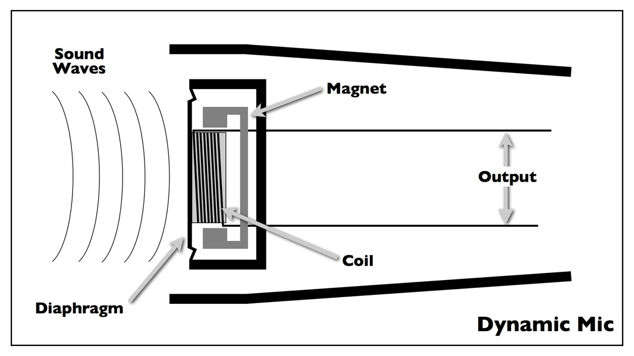

Slide 6
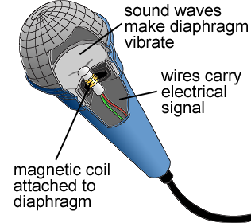
Dynamic mic

Slide 7
DYNAMIC MIC ADVANTAGES | DYNAMIC MIC DISADVANTAGES
Robust and durable | Resonant peak in the frequency response
Can be relatively inexpensive | Typically weak high-frequency response beyond 10kHz or so
Insensitive to changes in humidity
Needs no external or internal power to operate
Can be made fairly small
Resonant peak in the frequency response
Typically weak high-frequency response beyond 10kHz

Slide 8
Ribbon Microphone
Operates on almost the same principle as the dynamic mic.
Major difference: the transducer is a strip of aluminum foil wide and light enough to be vibrated directly by the sound pressure – no diaphragm is needed.
The electrical signal generated is so small it must be amplified by an internal transformer.

Slide 10
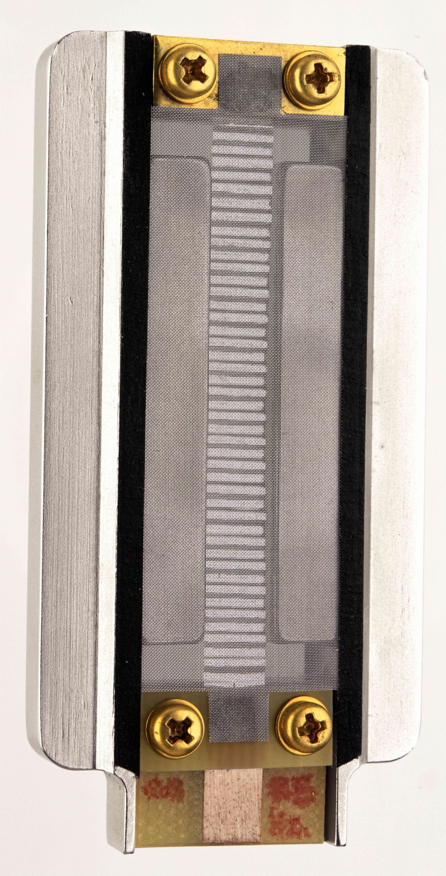
Royer R-121
Ribbon Element

Slide 11
RIBBON MIC ADVANTAGES | RIBBON MIC DISADVANTAGES
Relatively flat frequency response | Fragile – requires care during operation and handling
Extended high frequency response as compared to dynamics | Moderately expensive
Needs no external or internal power to operate | The ribbon element my be destroyed if 48 volt phantom power is applied

Slide 12
Condenser Microphone
The condenser mic has two electrically charged plates, one that moves (diaphragm) and one that is fixed call the backplate.
This is a capacitor (also called a condenser) with positive and negative charged electrodes and air space between the plates.
Sound pressure vibrates the diaphragm and pushes it toward the backplate which causes the condensor to “capacitate” or store energy that can be amplified.
The capacitance creates a very small voltage and must be amplified – boosted with outside power – Phantom power or battery power.

Slide 13
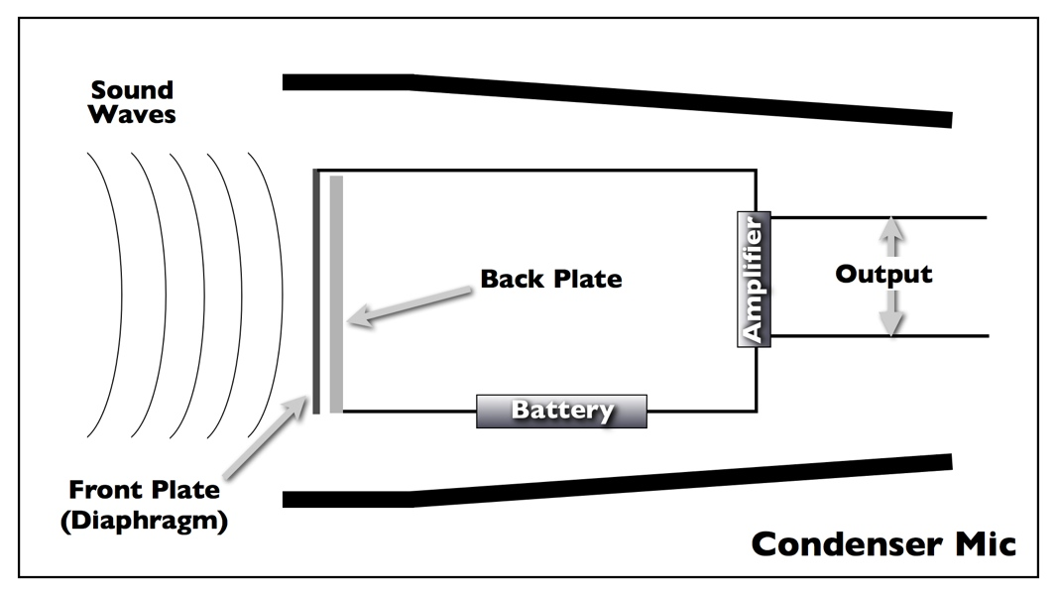

Slide 14
CONDENSER MIC ADVANTAGES | CONDENSER MIC DISADVANTAGES
Excellent high frequency and upper harmonic response | Moderate to very expensive
Can have excellent low frequency response | Requires external powering
Excellent transient response | Low cost models can suffer from poor or inconsistent frequency response
 | Two mics of the same model may sound somewhat different
 | Humidity and temperature affects performance

Slide 15
Directional Response
The way in which a mic responds to sound…
Omni-directional
Figure 8 or Bi-directional
Cardiod
Hyper-cardiod

Slide 16
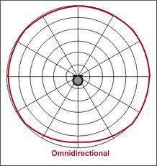
Omni-directional

Slide 17
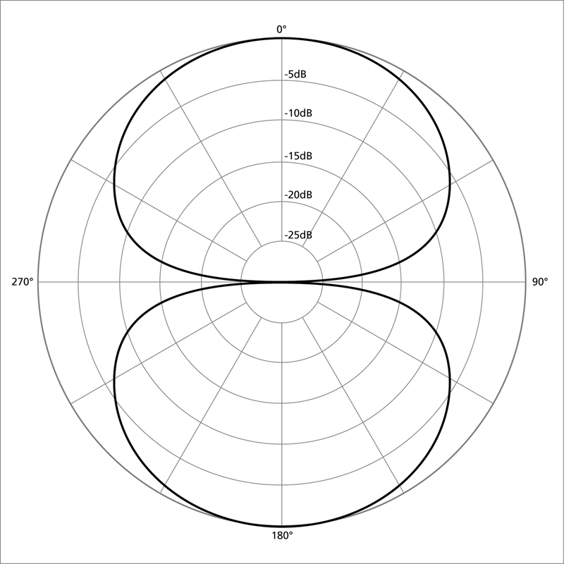
Figure 8 or Bi-directional

Slide 18
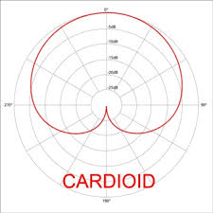
Cardioid

Slide 19
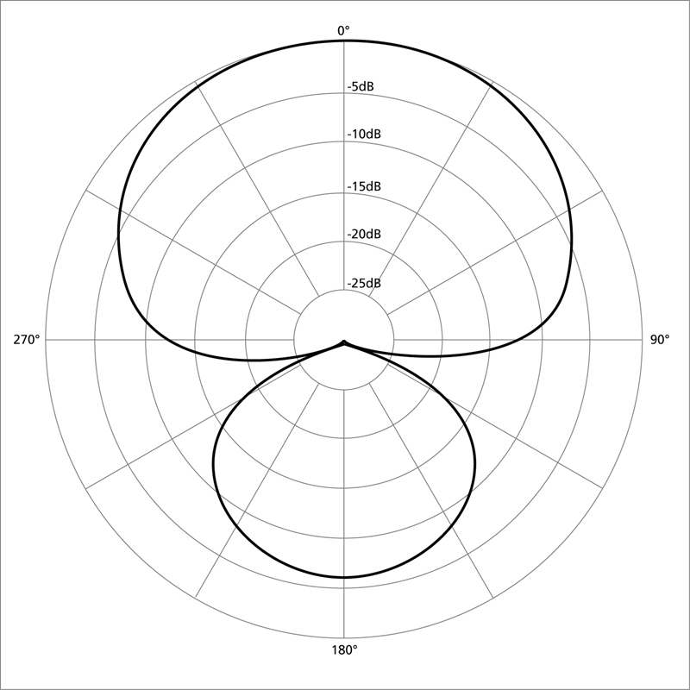
Hyper-cardioid Super-cardioid

Slide 20
Specialty Microphone
While most microphones can be used for a number of different applications there are some that serve a specific function. There are several worth looking at…

Slide 21
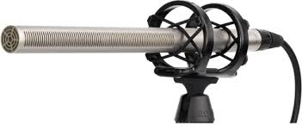
Shotgun Mic

Slide 22
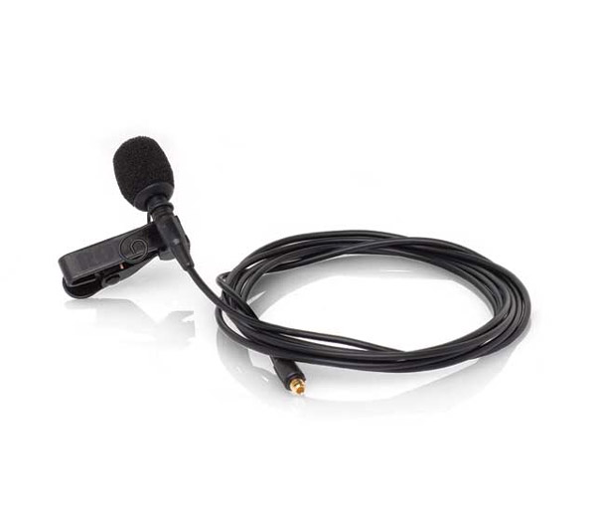
Lavaliere Microphone

Slide 23
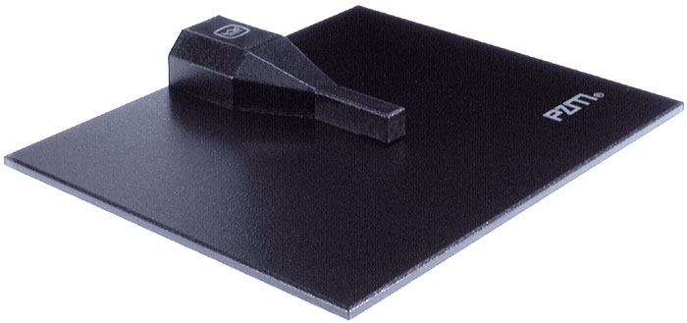
PZM (Pressure Zone) Microphone

Slide 24
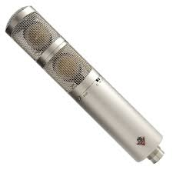
Stereo Microphone

Slide 25
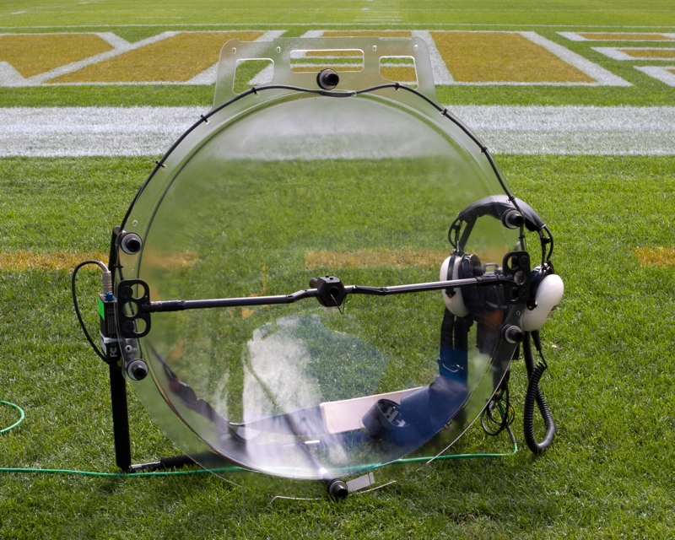
Parabolic Microphone

