Slide 1
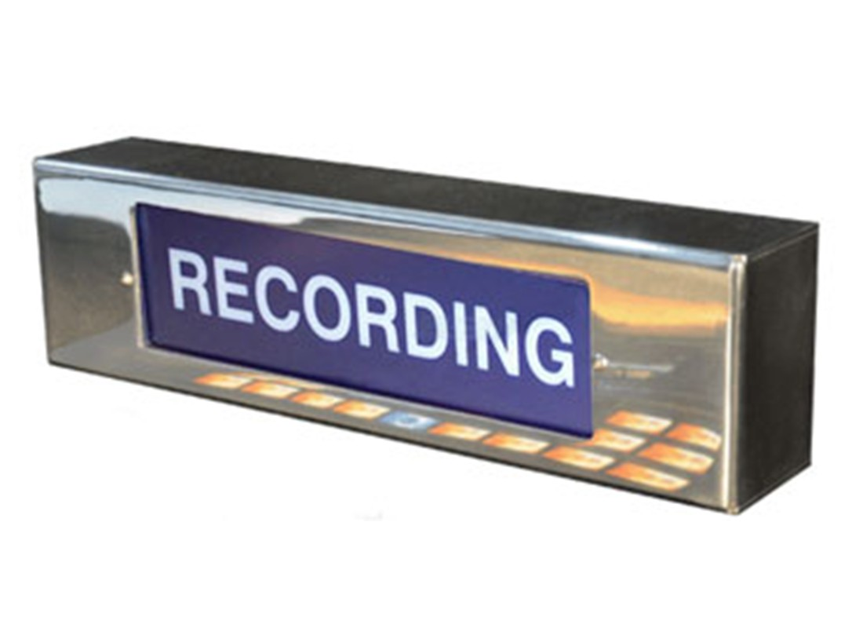
Inspire School of Arts and Science
Jim White

Slide 2
Equalization (EQ)
Equalization means boosting or cutting specific frequencies within an audio signal.
A device that performs equalization is called an Equalizer, or more commonly, simply an EQ

Slide 3
Boost/Cut - The amount (usually in decibels) that the specific frequency is boosted or cut. Attenuation = cut
Frequency - The specific frequency (in Hz or KHz) that is being boosted or cut.
Q (Bandwidth) - Q is the range of frequencies around the center point that is boosted or cut.

Slide 5
Graphic Equalizers
Graphic Equalizers are called “graphic” because the controls are meant to represent a graph along the frequency ranges that they boost and cut (attenuate). Graphic EQ's are easy to use, but have fixed frequency ranges and Q, so are less flexible.

Slide 6
Parametric Equalizers
Parametric Equalizers offer you greater flexibility than graphical EQ's, as they typically have separate controls for boost/cut, frequency, and Q. This allows you to tailor the EQ curve to your needs.

Slide 7
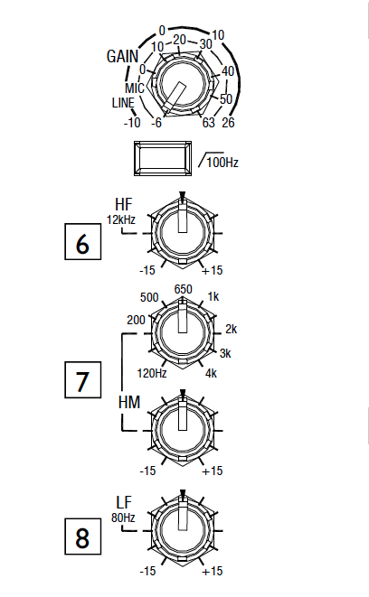
Allen & Heath Zed 24 (Sound console in IC22)

Slide 8
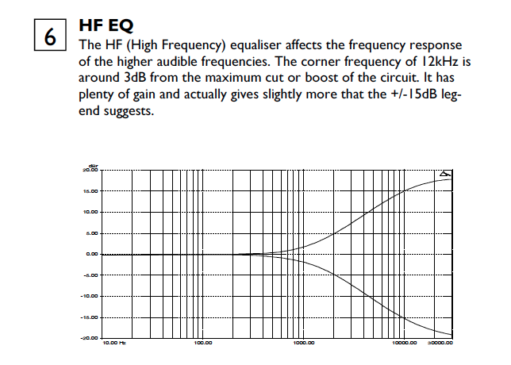

Slide 9
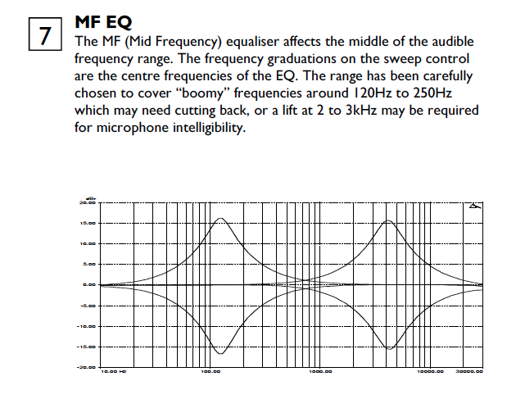

Slide 10
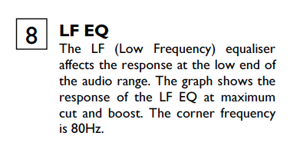
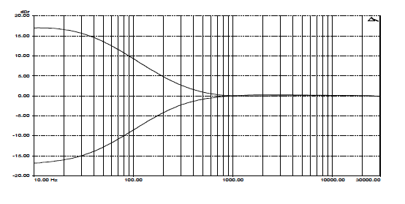

Slide 11
Low Pass Filter (LPF) or Low Shelf
Only allows low frequencies through. It behaves similarly to a bass knob on your stereo. A Low Shelf EQ will boost or cut the amplitude of frequencies starting at the selected frequency and then below.

Slide 13
High Pass Filter (HPF) or High Shelf
Only allows high frequencies through. It behaves similar to a treble knob on a stereo. A High Shelf EQ will boost or cut the amplitude of frequencies starting at the selected frequency and then above.

Slide 14
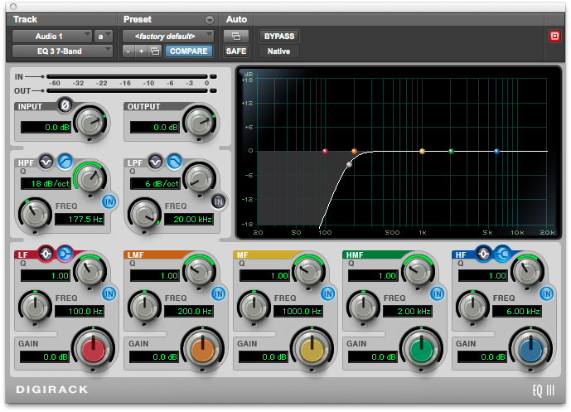

Slide 15
How to use EQ
Initially, go through each sound and apply EQ (if needed) to remove low end rumble or high end noise. This is a SUBTRACTIVE process where there is NO boosting of any frequency. Remember: boosting frequencies can add noise.
If you are removing more than -6dB at any frequency then the problem should have been taken care of by microphone placement or using baffles when you record.

Slide 16
What is the most predominant sound? The Voice? The Guitar? Start with that sound. Make it sound as good you can by using EQ only (no reverb, no delay, no chorus, no effects). This is to get the overall sound correct. Then you can adjust levels and add effects.
Add the next most important sound and adjust EQ, continuing to add tracks until you hear the entire mix.

Slide 17
While trying to make instruments, drums, and vocals sound good by themselves, it is important to know which instruments share similar frequency ranges. These instruments may interfere with each other.
Often the low end of a guitar interferes with the top end clarity of the bass.
As tracks are added, go back and adjust EQ as necessary to keep the mix clean and clear.

Slide 18
Brilliance: 6kHz to 16kHz
Presence: 4kHz to 6kHz
High Mids: 2kHz to 4kHz
Low Mids: 250Hz to 2kHz
Bass: 60Hz to 250Hz
Sub-Bass: 16Hz to 60Hz

Slide 19
Octave Band | Effect
31Hz | Rumble, “chest”
63Hz | Low sounds
125Hz | Boom, thump, warmth
250Hz | Fullness or mud
500Hz | Honk
1kHz | Whack
2kHz | Crunch
4kHz | Edge
8kHz | Sibilance, definition, “ouch!”
16kHz | Air

Slide 20
below 20Hz- This is below the range of human hearing. At very high volumes of the this frequency you physically feel it.
below 40 Hz- These are very low frequencies that are responsible for most muddy sounds. These frequencies can use up most of the capability of a power amp and speakers. Use this frequency sparingly. Meters will get louder, but you won't hear a big difference in the volume of your mix.

Slide 21
60Hz - kick drum, bass, hum. 60 Hz hum really interferes with kick drums and bass guitar frequencies. You boost this frequency and you boost the AC hum.
80Hz - bass guitar
120-180Hz - tom drums
200 Hz - the sharp attack sound of a bass guitar

Slide 22
250-300Hz – a "cardboard box" sound vs clean “thump” you get when recording things in a room, especially drums, especially Kick.
1000Hz (1kHz) - first boostable section of the human voice. good for boosting voices in a film.
2000Hz (2kHz) - "Click" of a bass drum.

Slide 23
3kHz - best “boostable” area of human voice, and great for pushing a sound through a small speaker, use this to boost voices for TV.
5 - 8 kHz - Sibilance (the "Sssss" sounds produced by the voice).
Above 10kHz- very high frequencies and main part of audible hiss.
Above 20kHz- out of human hearing range, but energy can still overload system

