Slide 1
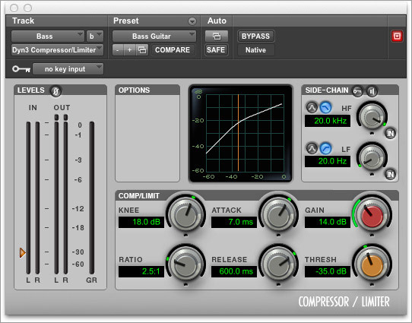
Compression
Inspire School of Arts and Science

Slide 2
What is compression?
As the name implies, compression “compresses” “squashes” or reduces the dynamic range of a signal.
It is used extensively in audio recording, production work, noise reduction, and live performance applications
It is often said that compressors make loud sounds quieter and quieter sound louder – though not the whole story.

Slide 3
The aim when compressing audio is to reduce the dynamic range by lowering the level of the loudest parts, creating a more balanced sound. Compression is not to be confused with adjusting the fader or level automation, yes compression does control dynamics but it can also add sonic qualities as well.
Careful compression can produce a definitive and well balanced consistent mix, poor compression can cause mixes to sound weaker than they did by causing slurring and imbalance.

Slide 4
A compressor is basically a variable gain device, where the amount of gain used depends on the level of the input. In this case, the gain will be reduced when the signal level is high which makes louder passages softer, reducing the dynamic range.

Slide 5
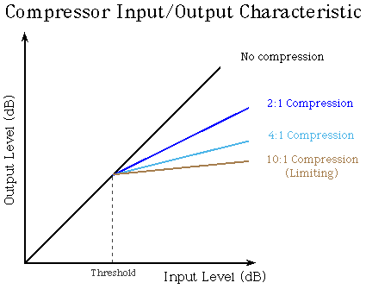
The horizontal axis corresponds to the input signal level, and the vertical axis is the output level (both measured in decibels). A line at 45 degrees corresponds to a gain of one - any input level is mapped to exactly the same output level. The compressor changes the slope (makes it more horizontal) of that line above a chosen value called the threshold.

Slide 6
The compressor weakens the input signal only when it is above the threshold value. Above that threshold, a change in the input level produces a smaller change in the output level.

Slide 7
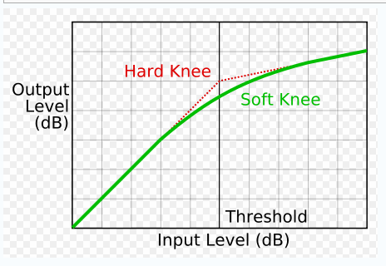
Hard Knee…Soft Knee

Slide 8
The compressor setting is usually stated as a ratio, such as 2:1, which means that the input level would have to increase by two decibels to create a one decibel increase in the output.
With a 4:1 setting, the input would need to change by 4 dB for a 1 dB change in the output level, and so on.
Limiting is simply an extreme form of compression where the input/output relationship become very flat (10:1 or higher). This places a hard limit on the signal level.

Slide 9
The amount of time the compressor takes to respond when the input level rises above the threshold is called the attack time, and is usually fairly short (under 100 ms.).
When the input level is above the threshold and then drops below it, the compressor will take some time to increase the gain as well. This is the release time of the compressor, which is generally larger than the attack time (possibly up to a second or two).

Slide 11
Threshold : This highly important setting (in dB) determines the level at which the compression reduction kicks in. For example a threshold setting of -6dB would mean that any signal above this level would be compressed.

Slide 12
Ratio : The “ratio” determines how much gain reduction is applied after a signal passes the set threshold value. A ratio setting of 3:1 means that for every 3dB over the threshold, the level is reduced to 1dB over the threshold. So, at 3:1, if the level is 9dB over, the output will be 3dB over the threshold. A higher ratio is referred to as ‘hard’ compression, whereas a lower ratio, such as 2:1 or 3:1 is a softer approach.

Slide 13
Attack : This is the time (in milliseconds) taken for the compression to kick in after the threshold has been passed. Too fast an attack could ruin the transient attack of a signal while an attack which is too slow may cause the compression to kick in too late and therefore not provide a quick enough response to the louder sections.

Slide 14
Decay : Decay is the time taken (in milliseconds) for the reduction in level to return after dropping below the threshold once more. A slow decay can be used to give a sense of additional sustain to a signal, while a quick delay can create punchy and fast hitting sounds.

Slide 15
Gain : This is the volume adjustment made to the signal following compression, generally referred to as ‘make-up gain’ as it is commonly used to bring the entire signal back up after reducing the louder elements, therefore increasing the gain of the entire, more balanced signal.

Slide 16
Uses
Compression does not really have any rules, there are of course good starting points for different instruments, but just like most other mixing techniques it comes down to the engineers taste, and more importantly what the mix requires.

Slide 17
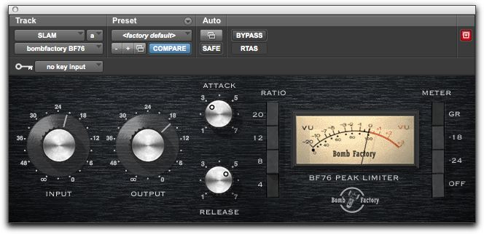
As stated earlier…
Limiting is simply an extreme form of compression where the input/output relationship becomes very flat (10:1 or higher). This places a hard limit on the signal level.
Pro Tools has a plug-in limiter called Bomb Factory

