Slide 1
The Development of Electronic Music Part 1

Slide 2
The Age of Innovation (1865-1910)
In the late 1800’s musicians began to experiment with emerging technology to compose and create sounds. Most of the inventions were made by engineers that discovered the musical properties or abilities of the technology they were working with
and inventing.

Slide 3
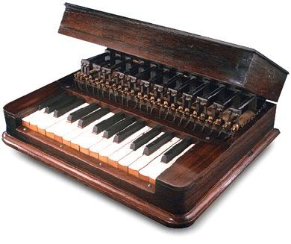
Elisha Gray (August 2, 1835 – January 21, 1901) was an American electrical engineer who co-founded the Western Electric Manufacturing Company. Created an instrument called the “Musical Telegraph”
Notes:
December 29, 1874, Gray gave the first public demonstration of his invention for transmitting musical tones and transmitted “familiar melodies through telegraph wire” according to a newspaper announcement. This was the first electric music synthesizer using self vibrating electromagnetic circuits that were single-note oscillators operated by a two-octave piano keyboard. The “Musical Telegraph” used steel reeds whose oscillations were created by electromagnets and transmitted over a telegraph wire. Gray also built a simple loudspeaker in later models consisting of a vibrating diaphragm in a magnetic field to make the oscillator tones audible and louder at the receiving end.

Slide 4
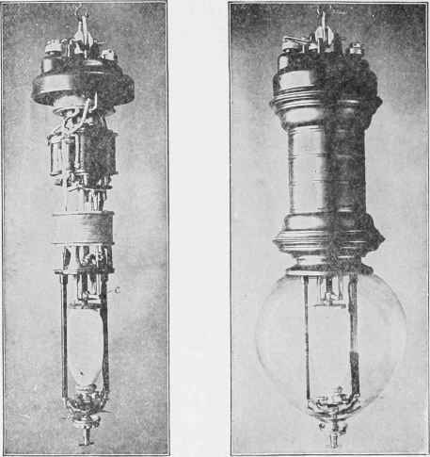
The predecessor to Thomas Edison’s light bulb in the US was the Carbon Arc Lamp. This street lighting was widespread in Europe, yet had an annoying audible hum. William Duddell was appointed to solve the problem in London in 1899. During his experiments he found that by varying the voltage supplied to the lamps he could create controllable audible frequencies from a resonant circuit caused by the rate of pulsation of exposed electrical arcs. By attaching a keyboard to the arc lamps he created one of the first electronic instruments.

Slide 5
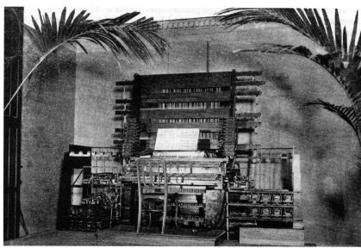
Telharmonium, developed by Thaddeus Cahill in 1897. The Telharmonium was intended to be listened to using telephone receivers. The Mark II version weighed almost 200 tons and the main portion of it filled a room. In 1906 small number of performances in front of a live audience in NYC were given in addition to the telephone transmissions using large paper cones

Slide 6
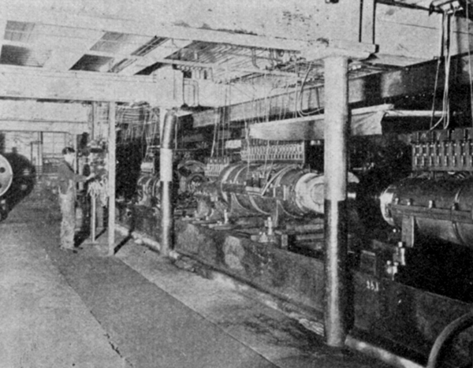

Slide 7
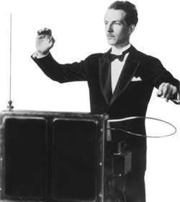
^{Theremin (1919)}
The first electronic instrument is often viewed to be the Theremin, invented by Professor Leon Theremin 1919–1920. It is unique in that it was the first musical instrument designed to be played without being touched. It consists of two radio frequency oscillators and two metal antennae.. Bob Moog constructed his own theremin as early as 1949. Today, Moog Music is the leading manufacturer of theremins.

Slide 8
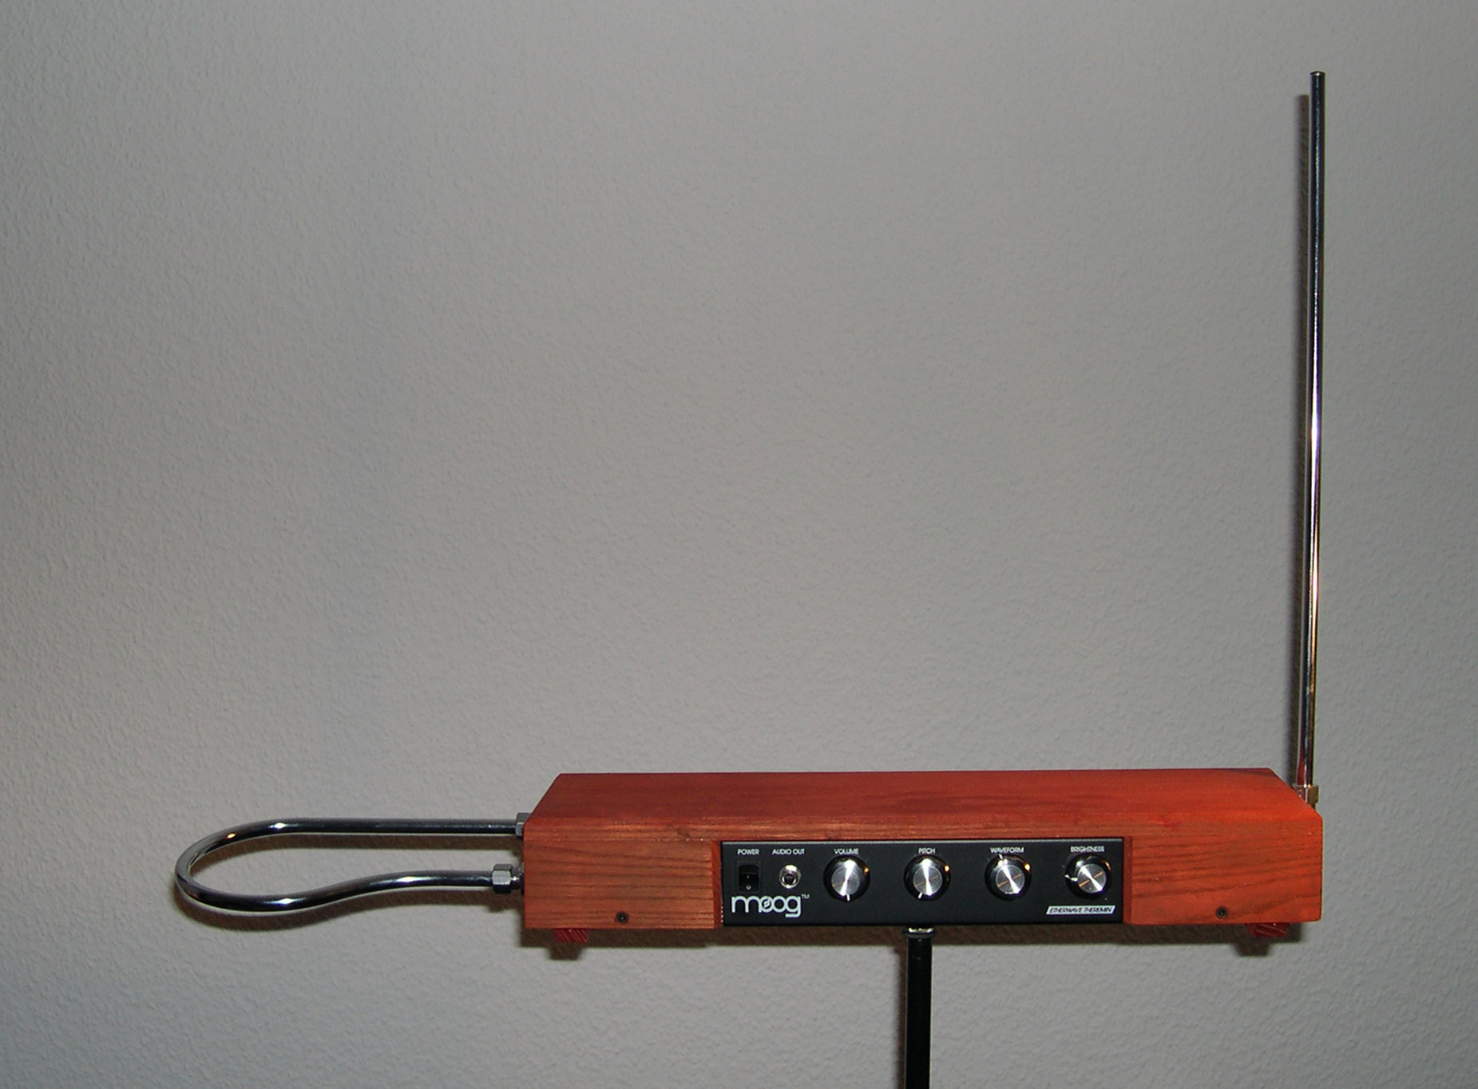

Slide 9
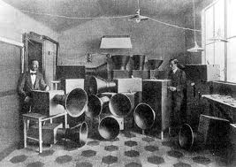
^{Intonarumori (1921)}
Luigi Russolo gave a concert in Paris in 1921 with the intonarumori
(noise makers in boxes with a crank to produce the sound) and
caught the attention of Ravel and Stravinsky.

Slide 10
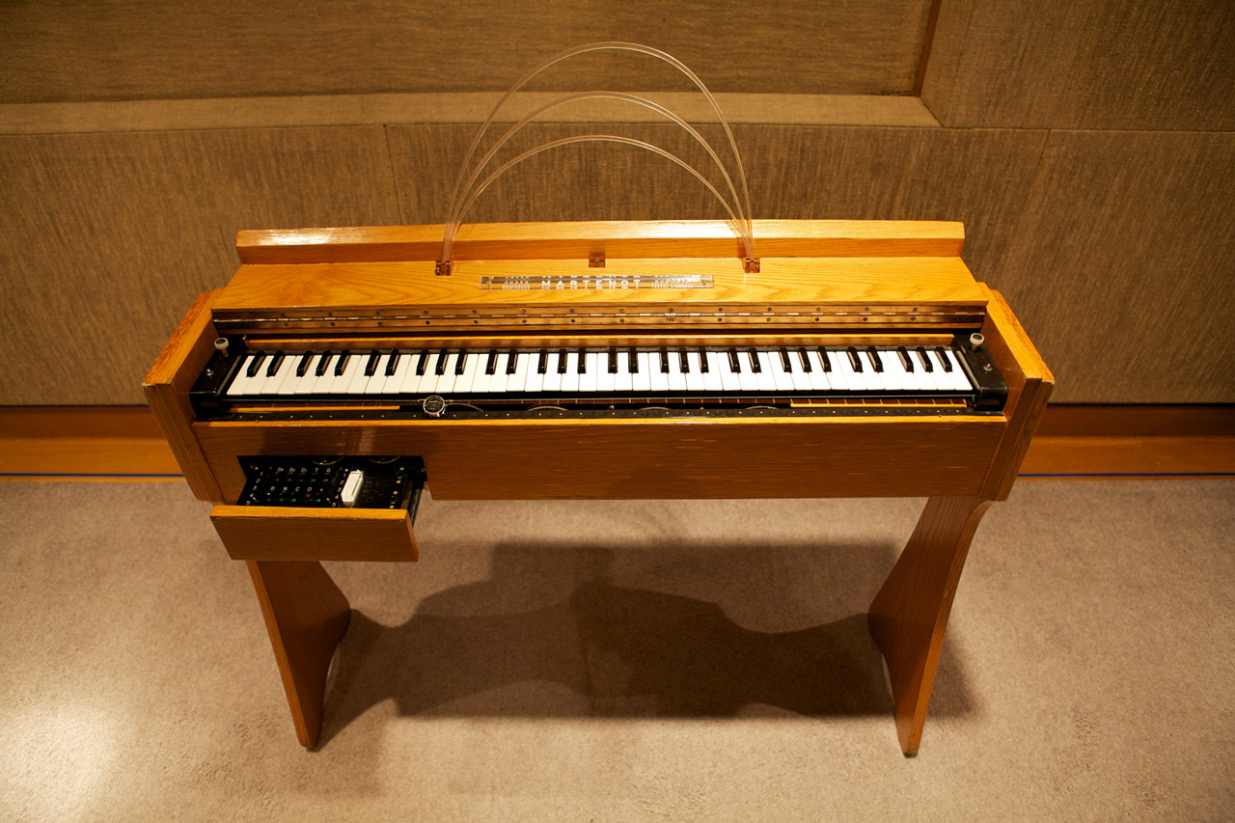
The most successful instrument developed during this period was the Ondes Martenot (pronounced "owned Martin O"), developed by Maurice Martenot (1898-1980). It sounded a lot like a Theremin and used similar technology..

Slide 11
Musique Concrete, Electronic Music, Tape Music
^{(1950s-1960s)}
The tape recorder was invented in Germany during World War II. It wasn't long before composers used the tape recorder to develop a new technique for composition called Musique Concrète. This technique involved editing together recorded fragments of natural and industrial sounds on tape. Traditionally, classical music begins as an abstraction, as musical notation on paper, which is then produced into audible music. Musique concrète is the other way around, starting with "concrete" sounds which are then abstracted into musical compositions.

Slide 12
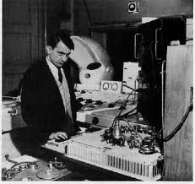
Pierre Schaeffer (Father of Musique Concrete, 1910-1995) **
The first pieces of musique concrète were written by Pierre Schaeffer, who first performed with it live in 1950. While an engineer at a TV station in France, Pierre Schaeffer experimented with sounds using their equipment (mainly turntables), playing sounds backwards, slowing them down, speeding them up and juxtaposing them with other sounds. These techniques were virtually unheard of at the time. After gaining recognition, he acquired a tape recorder in 1951 and began composing musique concrete.

Slide 13
Louis (1920-1989) and Bebe Barron (1927-2008) **
The first electronic music for magnetic tape composed in America was completed by Louis and Bebe Barron in 1950. Theirs differed in that instead of using "real world" concrete sounds, they developed electronic devices which produced sounds by calculating mathematical equations, and recorded these electronic sounds onto tape. They wrote the soundtrack and theme song for Forbidden Planet which set the standard for other science fiction movies of the time.

Slide 14
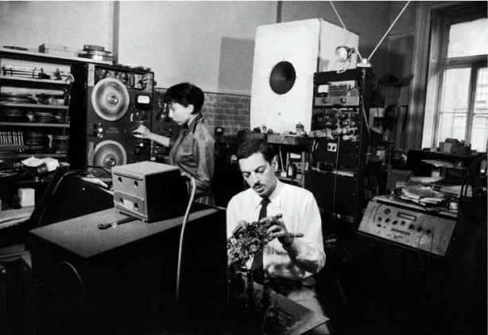

Slide 15
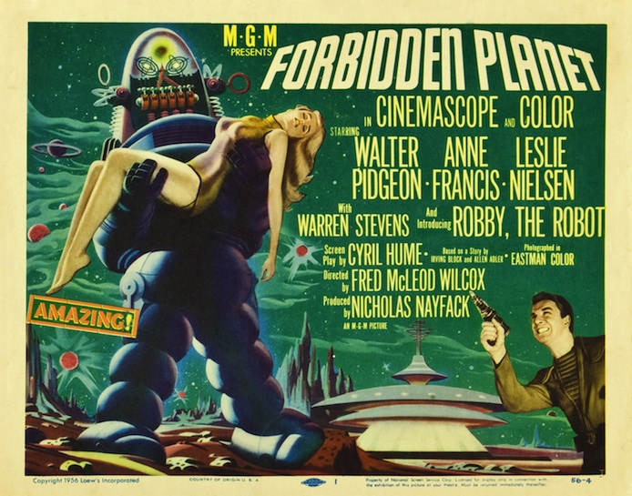

Slide 16
The Golden Age of Electroacoustic & Computer Music (1958-66)
By the mid-1950s, the eventual commercial potential of electronic musical instruments was becoming clear and many companies entered the field. Two new electronic instruments made their debut in 1957. Unlike the earlier Theremin and Ondes Martenot, these instruments were hard to use, required extensive programming, and neither could be played in real time.

Slide 17
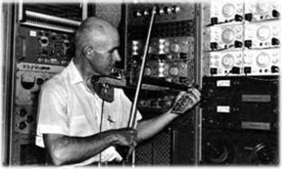
Max Mathews (Father of Computer Music, ¹⁹²⁶ ⁻²⁰¹¹⁾
The first of these electronic instruments was the computer when Max Mathews wrote a program called Music 1, after hours at Bell Laboratories.

Slide 18
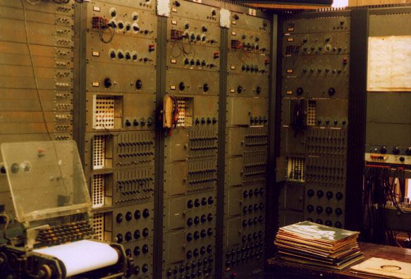
^{RCA Mark II Sound Synthesizer}
The other electronic instrument that appeared that year was the first electronic synthesizer, designed by RCA. Called the RCA Mark II Sound Synthesizer, it used vacuum tube oscillators and incorporated the first electronic music sequencer.

Slide 19
The First “Playable” Synthesizers (mid 1960s)
Musique Concrete was clumsy, as were room-filled synthesizers such as the RCA Mark II Synthesizer, and Max Mathew’s Music V computer program. This led to some simultaneous independent teams to develop the world’s first “playable” electronic synthesizers. These “modular synthesizers” were relatively easy to program using patch cables, but still not... easy.

Slide 20
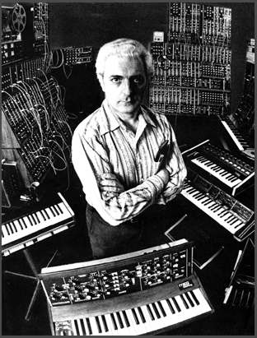
Bob Moog (Father of Synthesis, 1934-2005)
Bob Moog was producing his own brand of Theremins in the 1950s when he met a musician who prompted him to make other electronic music devices. This lead to Bob Moog developing some of the first modular electronic synthesizers, which became commercially successful. He used the word Synthesizer for the first time in 1967.
By 1969 Moog was enjoying success with mainstream artists using his modules. He continued to develop a full line of synthesizers which are still popular to this day, including the Mini-Moog and Little Phatty.

Slide 21
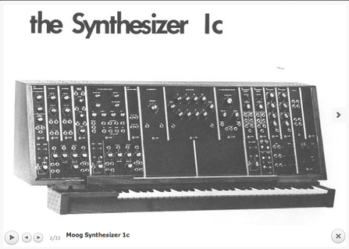

Slide 22
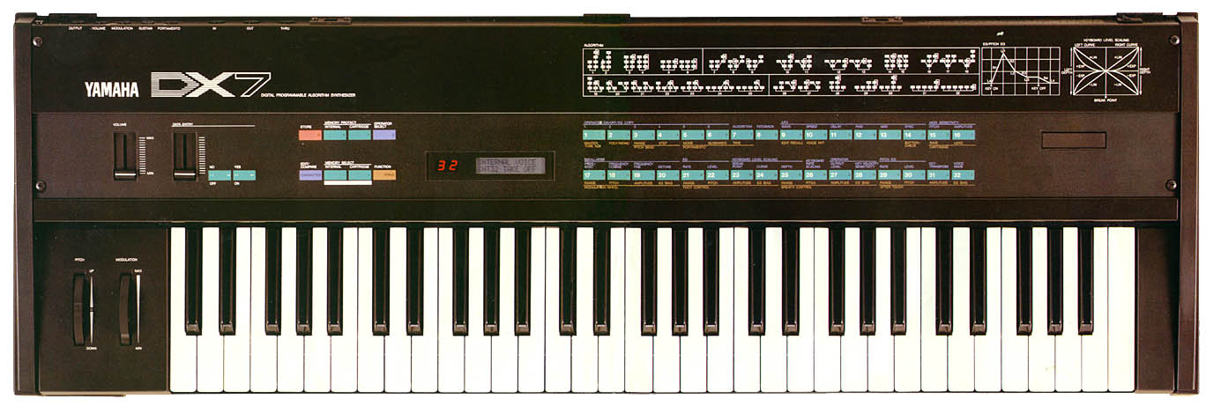
The First Digital MIDI Synthesizers (mid 1980s)
^{John Chowning (born in 1934)}
John Chowning is known for having discovered the FM synthesis (Frequency Modulation) algorithm in 1967. He developed the most famous synthesizer of the 1980s, the DX7, produced by Yamaha. Its electric piano became a standard sound in ballads, its bass was the standard bass sound, typically played in bouncy octaves. Its crystalline timbres were such a departure from the world of analog.

Slide 23
^{Roland D50 (1987)}
The Roland D-50 was marketed as the antidote to the Yamaha DX7’s unfriendly interface and non-intuitive synthesis architecture. Its main selling point was the short, ROM -sampled attack transients that were grafted onto voices generated by a software simulation of a conventional analog synthesizer, in the name of realism.

Slide 24
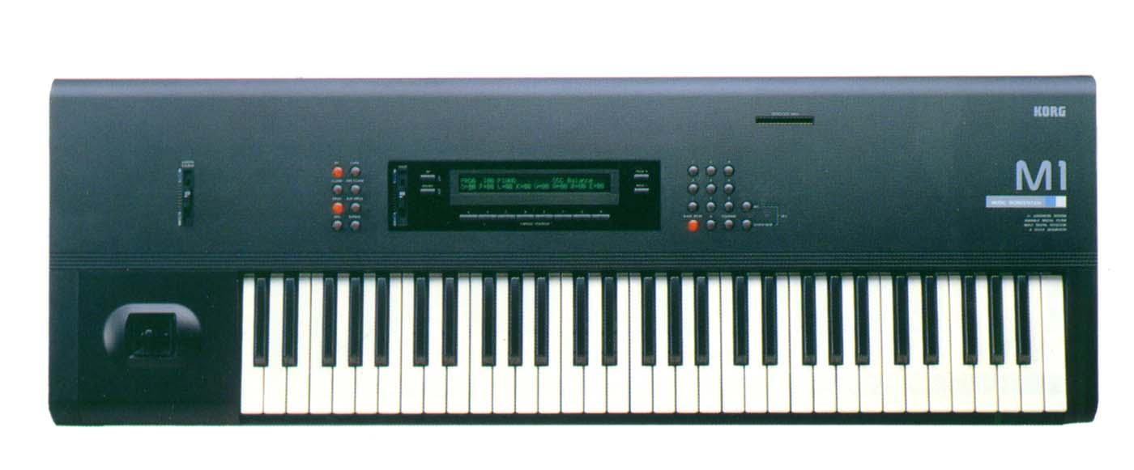
^{Korg M1 (1988)}
The Korg M1 also used PCM samples to create sounds that were clear, vibrant and very acoustic sounding. The M1 is also a workstation with eight-part multi-timbral capacity, a generous amount of polyphony (16 voices),plenty of ready-to-go sounds and drum kits, onboard multi effects and a powerful sequencer.

Slide 25
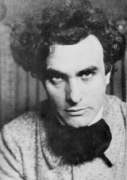
“Poem Electronique”
1958
Edgard Varèse (Father of Electronic Music)
Edgard Varèse was the inventor of the term "organized sound", a phrase meaning that certain timbres and rhythms can be grouped together, sublimating into a whole new definition of sound. Although his complete surviving works only last about three hours, he has been recognized as an influence by several major composers of the late 20th century. His use of new instruments and electronic resources led to his being known as the "Father of Electronic Music"

Slide 26
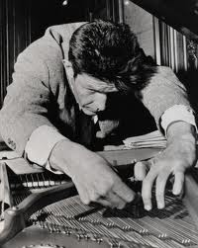
^{John Cage (1912-1992)}
John Cage was an American composer. He was a pioneer of chance music, non- standard use of musical instruments, and electronic music. He is perhaps best known for his 1952 composition 4'33", whose three movements are performed without a single note being played. Though he remains a controversial figure, he is generally regarded as one of the most important composers of his era.

Slide 27
^{Wendy Carlos (born in 1939)}
Wendy Carlos has done groundbreaking work in electro acoustic music since the1960s. Carlos worked as a recording engineer and befriended Robert Moog.
Her 1968 recording Switched-On Bach hit platinum sales, which propelled the Moog synthesizer into the public consciousness. She introduced the use of vocoders for synthesized singing in her score for Stanley Kubrick's film, A Clockwork Orange.
Carlos wrote horror music for Kubrick's The Shining, and composed the score for the 1982 Disney filmTron. In 1986, Carlos turned to a lifelong interest in alternate scales and musical tunings.

